Slide 1
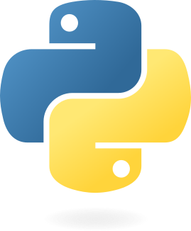


Python programming for the movement sciences
Jill Emmerzaal, Vaibhav shah, Bryce A Killen, Robbin Romijnders, Clint Hansen, Philippe C. Dixon

Slide 2
Why learn Python
Notes:
This seminar is hardly enough for you to learn Python. Therefore, the aim is to give you a crude introduction to the language and give you the basic knowledge needed to get started.
The information in the introduction will be enough to understand basic python concepts that you will inspect in the tutorials. The accompanying Jupyter Notebook is there as a very succinct reference guide that you can use during the seminar.
Our goal, in this first introduction, will be to help you understand the syntax of the python language and its environment. We will also strive to give you a basic understanding of the python documentation so you’ll be able to read and implement the different libraries.

Slide 3
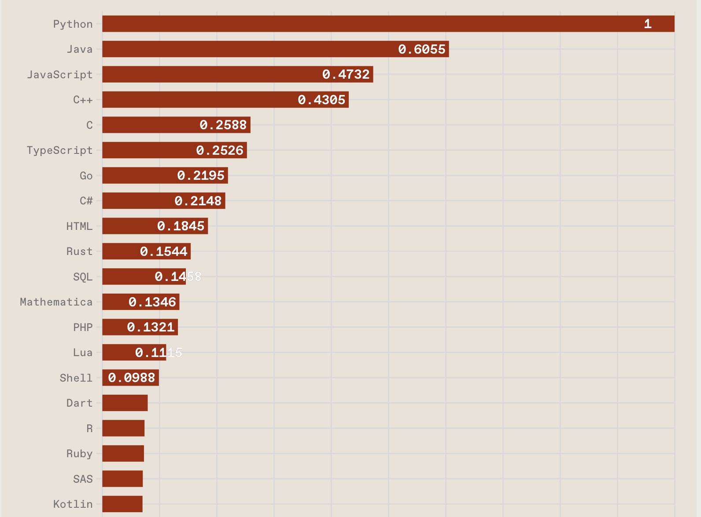
Why learn Python
Python is trending according to IEEE
Versatile with with broad applications
Free of charge
Has an easy, readable syntax
Extensive, powerful libraries
Interoperability with MATLAB
https://spectrum.ieee.org/top-programming-languages-2024

Slide 4
Extensive guides and references
If you are stuck, or you want to learn more, there are plenty of options
Corresponding notebook
Oficial Python tutorial
NumPy for absolute beginners
Thonny--easy IDE for debugging
Udemy courses like 100 days of code or python for data science and machine learning bootcamp
Notes:
Google and stack overflow are your friends.

Slide 5
Overview of content so far
We have officially started to learn python.
Python has powerful libraries to enhance the versatile use
Python and MATLAB can be used together

Slide 6
Start a Python Project

Slide 7
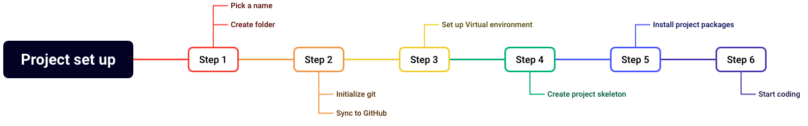
Basic structure to start a project
To keep things tidy
Notes:
It is slightly more relevant to follow a similar structure in all your python scripting. That has mainly to do with step 3: set up a virtual environment.
As mentioned, Python has a lot of functionality within in the standard library. But its strength lies in the rich ecosystem of Packages that can be added and used.
Packages are a collection of code that exists outside of the standard library. And for managing the packages, it is important to set-up a virtual environment.

Slide 8
Basic structure to start a project
To keep things tidy
Notes:
It is slightly more relevant to follow a similar structure in all your python scripting. That has mainly to do with step 3: set up a virtual environment.
As mentioned, Python has a lot of functionality within in the standard library. But its strength lies in the rich ecosystem of Packages that can be added and used.
Packages are a collection of code that exists outside of the standard library. And for managing the packages, it is important to set-up a virtual environment.

Slide 9
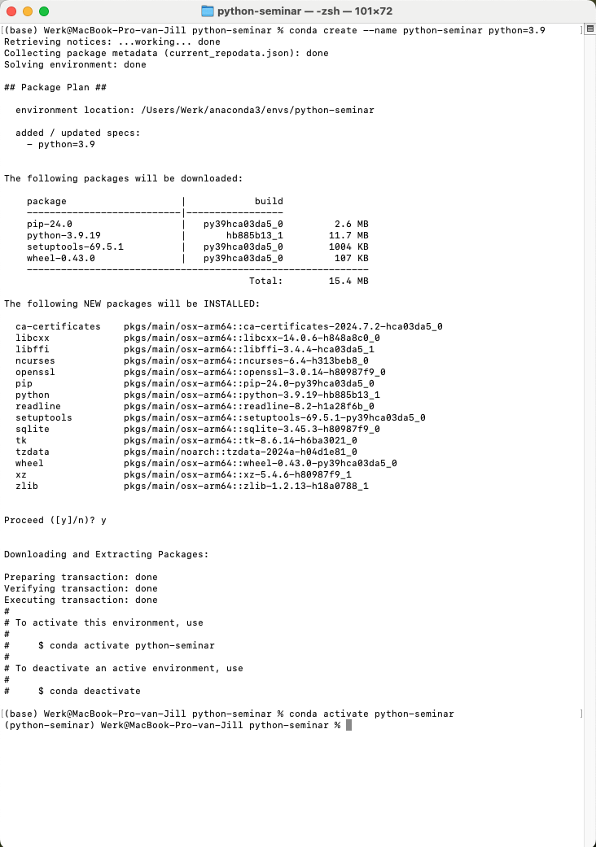
Step 3: Virtual environment
Part 1: Conda
conda create –name {project name} python=3.9
conda activate {project name}
{ } substitute to your own project name.
In this case python-seminar
Notes:
If you have followed the instructions on the shared repo, you have installed Miniconda, cloned the repository, navigated to the folder on your local system and installed the virtual environment.
Now, if you got stuck after step 1, no worries, I’ll walk you through the steps of setting up a brand new, shiny, and empty virtual environment.
And there you have it, a new environment. Once it’s activated, notice that the (base) at the start of the code line, has changed to the name of you package.

Slide 10
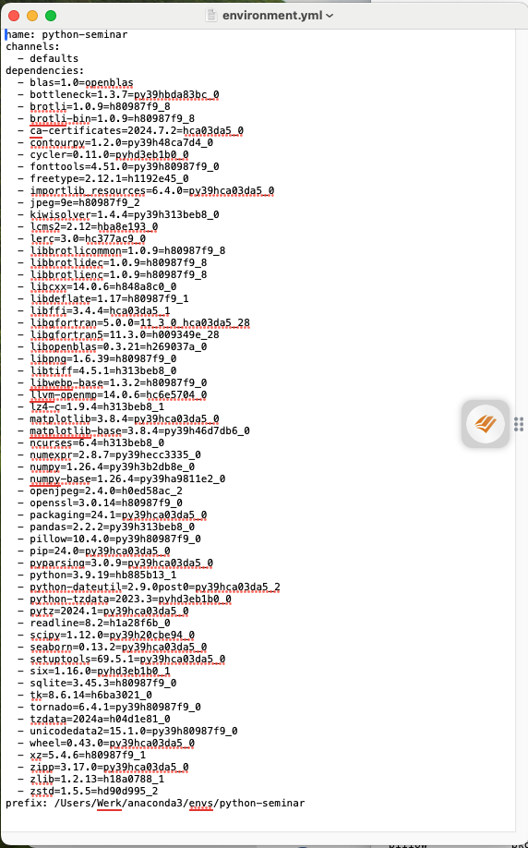
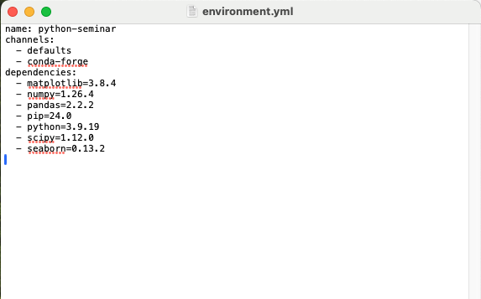
Step 3: Virtual environment
Part 2: exporting the environment
conda env export > environment.yml
Notes:
Now that we have our virtual environment, and the best thing to do is export a list so that you easily recreate your environment.
Command is conda env export > environment.yml
That creates the environment file within your folder.
But if you open this, it looks a lot different from the document that is on most repositories. This is because this environment file is specific to your device. If you want to create an environment file to share for another computer, you’d need to manually edit it.
The installation of the packages shown in the right figure will create the same environment as shown in the left.
So now that we have the first three steps competed, let’s go to step 4. Create a project skeleton.

Slide 11
Step 5: Install (project) packages
Conda versus Pip
Conda versus pip:
Conda is both a package manager and a virtual environment and can install big, complicated, non-python packages but not all packages can be installed through conda
Pip is just a package manager and can install only install Python packages but can install them all. Including local packages
conda install numpy pandas {} {} {}
OR
pip install numpy pandas {} {} {}

Slide 12
Step 6: Start coding

Slide 13
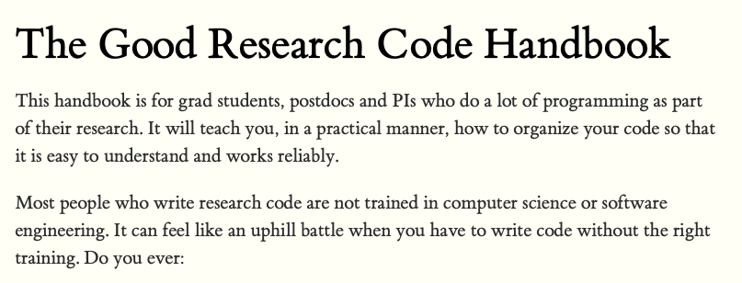
Take home message
Work for your future self
Using Virtual environments allows you to recreate the environment in the far future.
Good source is the the good research code handbook

Slide 14
Overview of content so far
We have created our first environment
We have installed our first packages
We’ve discussed the differences between conda and pip

Slide 15
What to use in Python scripting

Slide 16




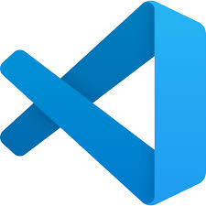
IDEs versus Notebooks
Choosing between an IDE and a notebook ultimately depends on the nature of your work and personal preference

Slide 17
IDEs
comprehensive, efficient, and robust environment for automation and batch processing
Developing large-scale applications or complex projects.
When you need robust debugging, refactoring, and version control tools.
Managing extensive codebases with multiple files and dependencies.
Performance-critical applications requiring efficient resource management.

Slide 18
Notebooks
Interactive, user-friendly, and collaborative platform ideal for data science and research tasks
Data analysis, exploration, and visualization tasks.
Prototyping and experimenting with code snippets.
Creating tutorials, reports, or research documentation.
Collaborative projects where sharing and reproducibility are key.

Slide 19
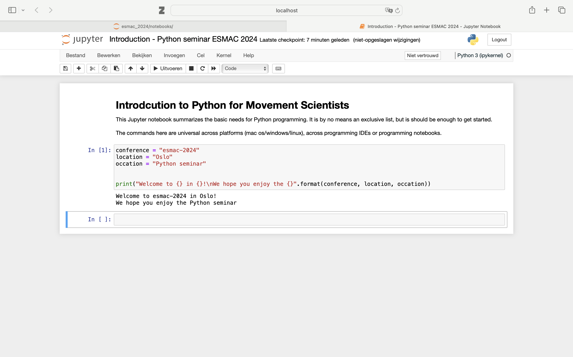
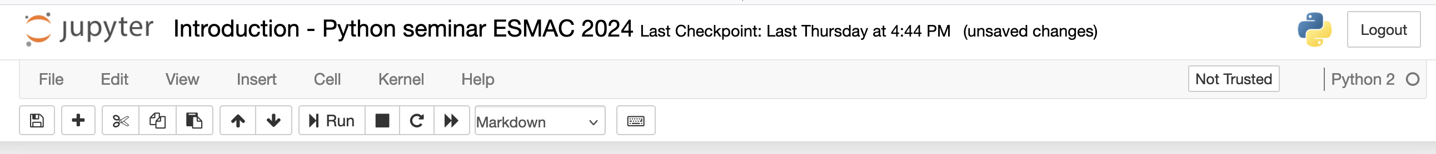
Navigating Jupyter Notebook
Local host in the background
Jupyter notebook
Add cell
Run cell
}
Markdown cell
Switch cell
}
Code cell
}
Output

Slide 20
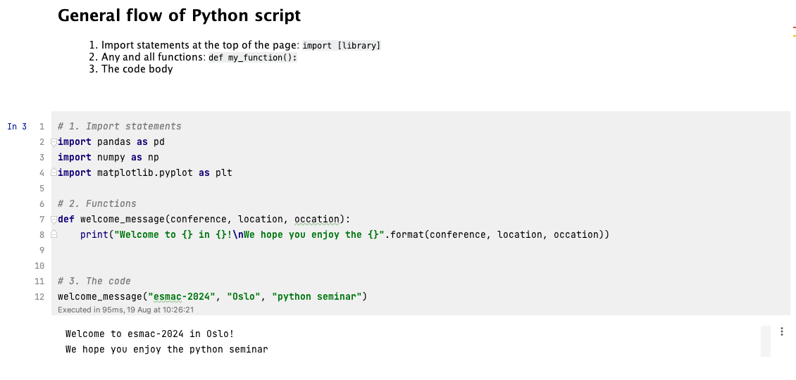
General flow of a python script
Text with goal of notebook
Import statements
Python functions
Python code
Code output

Slide 21
Overview of content so far
We know the difference between IDEs and Notebooks
We discussed the navigation of Jupyter Notebook
The basic outline for a Python script is demonstrated

Slide 22
Basic Python scripting

Slide 23
Understanding Data Types
There are 5 basic data types in Python
Textual
Strings
Numerical
Integer (int), floating point (floats), complex numbers
Booleans
True/False
Notes:
These are scaler types, meaning, single elements.
Note: The operations that can be done on the data depends on the data type (e.g. addition (*) works different on strings, then they do on numerical types)

Slide 24
Understanding Data Structures
Available through Python’s Standard Library
Lists
Dictionaries
my_list = [ item1, item2, item3 ]
my_dict = {"key1” : item1, "key2” : item2, ... }
my_list = [“subj_01”, “subj_02”, “subj_03”]
my_dict = {
"ppID": 1,
"sensor": "Sensor",
"data": [14, 47, 41, 6, 35, 12, 27, 48, 0, 25, 11, 36, 26, 28, 32]
}
Notes:
A way of organizing and storing grouped pieces of data in python. Usually, these pieces of data have a relationship with each other. This is also the way to store data in a certain order (e.g. time series data). Here lists and dictionaries are shown. Lists and dictionaries are part of the standard python library and form the basis of the python language.
Lists: my_list = [item1, item2, item3]
Can store any data type you'd want and can even combine them in a list
List output looks like an array [1, "hello", 2.2]
They can be modified and added onto when needed: my_list.append(item4)
Items can also easily be removed: my_list.remove(item2)
Dictionaries:
my_dict = {"key1": item1, "key2": item2, ... }
A dictionary contains a key, which is a string, with an associated item. This item can be whatever, a scalar, a list or other dictionary:
my_dict = {"ppID": 1, "sensor": "Sensor", "data": [14, 47, 41, 6, 35, 12, 27, 48, 0, 25, 11, 36, 26, 28, 32]}
It is very easy to index into dictionaries and explore its content:
To get the keys: my_dict.keys()
To get the content of a key: my_dict["data"]
To get a specific value of my data: my_dict["data"][4]
Indexing starts from 0

Slide 25
Understanding Data Structures
Available through Python’s Standard Library
Lists
Dictionaries
my_list = [ item1, item2, item3 ]
my_dict = {"key1” : item1, "key2” : item2, ... }
my_list = [“subj_01”, “subj_02”, “subj_03”]
my_dict = {
"ppID": 1,
"sensor": "Sensor",
"data": [14, 47, 41, 6, 35, 12, 27, 48, 0, 25, 11, 36, 26, 28, 32]
}
Notes:
A way of organizing and storing grouped pieces of data in python. Usually, these pieces of data have a relationship with each other. This is also the way to store data in a certain order (e.g. time series data). Here lists and dictionaries are shown. Lists and dictionaries are part of the standard python library and form the basis of the python language.
Lists: my_list = [item1, item2, item3]
Can store any data type you'd want and can even combine them in a list
List output looks like an array [1, "hello", 2.2]
They can be modified and added onto when needed: my_list.append(item4)
Items can also easily be removed: my_list.remove(item2)
Dictionaries:
my_dict = {"key1": item1, "key2": item2, ... }
A dictionary contains a key, which is a string, with an associated item. This item can be whatever, a scalar, a list or other dictionary:
my_dict = {"ppID": 1, "sensor": "Sensor", "data": [14, 47, 41, 6, 35, 12, 27, 48, 0, 25, 11, 36, 26, 28, 32]}
It is very easy to index into dictionaries and explore its content:
To get the keys: my_dict.keys()
To get the content of a key: my_dict["data"]
To get a specific value of my data: my_dict["data"][4]
Indexing starts from 0

Slide 26
Indexing
Offset from the start
Lists
Dictionaries
0
1
2
my_dict = {
"ppID": 1,
"sensor": "Sensor",
"data": [14, 47, 41, 6, 35, 12, 27, 48, 0, 25, 11, 36, 26, 28, 32]
}
subj_list = [“subj_01”, “subj_02”, “subj_03”]
-3
-2
-1
[14, 47, 41, 6, 35, 12, 27, 48, 0, 25, 11, 36, 26, 28, 32]
subj_list[0]
“subj_01”
my_dict[”data”]
subj_list[1:]
[“subj_02”, subj_03”]
my_dict[”data”][2]
41
Notes:
Contrary to matlab and some other programming languages where indexing starts from 1

Slide 27
Indexing
Into dictionaries
Lists
Dictionaries
0
1
2
my_dict = {
"ppID": 1,
"sensor": "Sensor",
"data": [14, 47, 41, 6, 35, 12, 27, 48, 0, 25, 11, 36, 26, 28, 32]
}
subj_list = [“subj_01”, “subj_02”, “subj_03”]
-3
-2
-1
[14, 47, 41, 6, 35, 12, 27, 48, 0, 25, 11, 36, 26, 28, 32]
subj_list[0]
“subj_01”
my_dict[”data”]
subj_list[1:]
[“subj_02”, subj_03”]
my_dict[”data”][2]
41
Notes:
Contrary to matlab and some other programming languages where indexing starts from 1

Slide 28
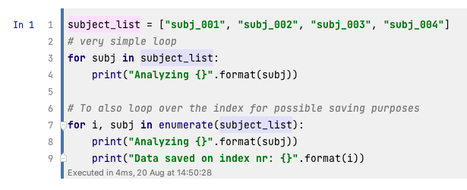
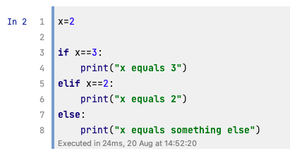
Python Loops and conditional statements
They depend on indentation
Notes:
Loops and conditional statements
There are a few things that are important when considering loops, statement (and also functions, but more on that later).
The first line always end with a colon ( : ). If the colon is missing you get a SyntaxError:
Indentation of the following lines are important. Either a tab of 4 spaces. Otherwise, you get an IndentationError:
If the colon is placed correctly, indentation should be automatic.
Contrary to MATLAB programming, a loop, conditional statement (or function) do not end with an end statement.
the end is indicated with a black line and a reset of the indentation

Slide 29
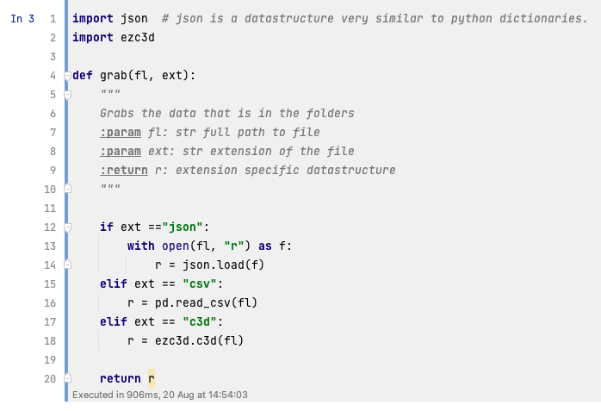
Python functions
Function inputs and function outputs
Keyword def
Necessary colon
Indentation is important
Return statement

Slide 30
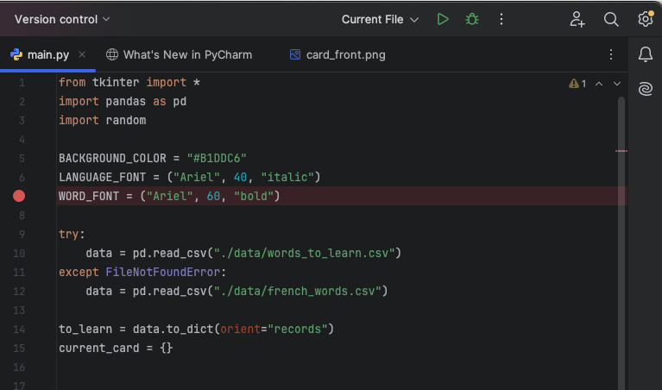
Debugging
Play computer and fix the issue
Jupyter Notebook has no debugging button
Small IDEs like Thonny
IDEs like PyCharm do
set a breakpoint (like MATLAB)
press the bug icon (NOT the run)
then “step into” the code
Notes:
Debugging can be a hassle in Python. Here in Jupyter Notebook, there is no debugging button you can click. The advantage of Jupyter notebook or Google Colab is that you can run cell by cell to see where you are going wrong. But it is harder to debug functions that way, as you cannot step into the function to see what happens. In those cases small and simple IDEs like Thonny can come in handy. Copy past your code, and visually see what happens. When using IDEs like PyCharm, DataSpell, ect, there is a debugging button. Just set a break point where you need it and run your script by pressing the bug icon. Then you can step into the code and see what is happening and find the error.

Slide 31
Overview of content
There are five basic data types and two basic data structures
Indexing starts from 0
Loops, conditional statements, and functions need indentation

Slide 32
Less basic Python scripting

Slide 33
Object Oriented Programming (OOP)
Python is currently one of the most popular programming languages that is built around OOP
Classes
The blueprints that models real-life object
Objects
The individual objects that are generated from the blueprint
Attributes
The characteristics/variables that define the objects
Methods
The functions of the objects.
Notes:
Object-Oriented Programming is a programming paradime based on objects or data rather than functions. This is approach is well suited for projects that are large and complex. The structure of OOP makes it exceptionally suited for collaborative development and code usability. Movement science project often have different aspects to them. Starting with extracting the data, some preprocessing steps, possible filtering or normalisation, the actual analysis e.g. step detection; and calculating the outcome variables. All these different components of a movement science project could be considered modules. When used correctly, OOP simplifies the relationships within the project. However, it might be hard to start with, as most programming is taught using a functions approach.
The first step in OOP is to identify all the objects you'd want to manipulate and how they relate to each other. The structure of OOP is as follows:
Python is currently one of the most popular programming languages that is build around OOP. The telltale use of the code has the structure of object.method(). For example: my_array.max()---find the maximum value in the array; or my_dataframe.head()---displays the first 5 rows of the DataFrame. Here, you have the object my_array or my_dataframe that is constructed from the class Array or DataFrame and using the functionality of the methods like max() or head(), the data can be manipulated.
Now that you know a bit about OOP, we can apply this knowledge on working with data. Every object, such as a numpy, pandas or pyplot object has methods associated with it. Tip: Within Jupyter notebook you can use the TAB button to get an overview of the available methods. For example: pd. + TAB

Slide 34
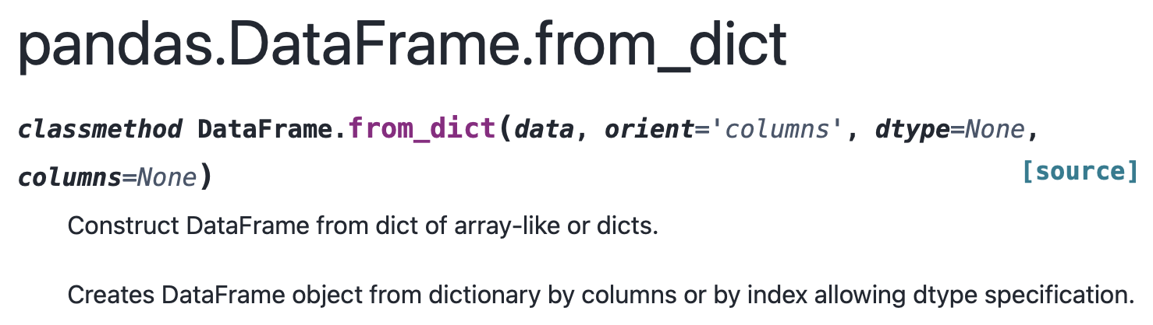
Working with data
conda install numpy
OR
pip install numpy
NumPy, pandas, SciPy, and Matplotlib
Standard structure for OOP: object.method()
Notes:
For movement science, the libraries that you will definitely encounter as movement scientist are: NumPy, pandas, SciPy, and Matplotlib. Before you are able to use these libraries, you need to make sure they are installed in your virtual environment. These three libraries work seamlessly together to get the best experience with handling large data-sets. Important for all these libraries, they all follow the OOP structure. What this means concretely: from the class blueprint of ndarray you create an array object b = np.arange(12).reshape(3, 4), and then you are able to directly apply the class methods on that object b.cumsum(axis=1). The same is true for the pandas DataFrame and matplotlib pyplot.
Tip: It is impossible to list all possibilities in this seminar, therefore NumPy: the absolute basics for beginners, pandas cheat sheet, SciPy User Guide and matplotlib quick start guide are a very usefull reference guides.

Slide 35
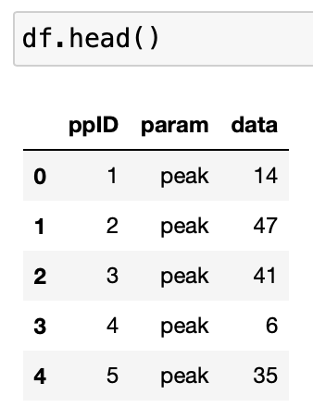
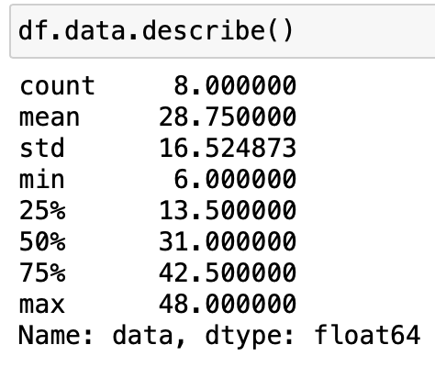
Working with data
NumPy, pandas, SciPy, and Matplotlib
object.method()
Concrete example with pandas:
my_dict = {
"ppID": [1, 2, 3, 4, 5, 6, 7, 8]
”param": ”peak",
"data": [14, 47, 41, 6, 35, 12, 27, 48]
}
Create the object from the class
df = pandas.DataFrame.from_dict(my_dict)
Notes:
For movement science, the libraries that you will definitely encounter as movement scientist are: NumPy, pandas, SciPy, and Matplotlib. Before you are able to use these libraries, you need to make sure they are installed in your virtual environment. These three libraries work seamlessly together to get the best experience with handling large data-sets. Important for all these libraries, they all follow the OOP structure. What this means concretely: from the class blueprint of ndarray you create an array object b = np.arange(12).reshape(3, 4), and then you are able to directly apply the class methods on that object b.cumsum(axis=1). The same is true for the pandas DataFrame and matplotlib pyplot.
Tip: It is impossible to list all possibilities in this seminar, therefore NumPy: the absolute basics for beginners, pandas cheat sheet, SciPy User Guide and matplotlib quick start guide are a very usefull reference guides.

Slide 36
Working with data
NumPy, pandas, SciPy, and Matplotlib
object.method()
Concrete example with pandas:
my_dict = {
"ppID": [1, 2, 3, 4, 5, 6, 7, 8]
”param": ”peak",
"data": [14, 47, 41, 6, 35, 12, 27, 48]
}
Create the object from the class
df = pandas.DataFrame.from_dict(my_dict)
Notes:
For movement science, the libraries that you will definitely encounter as movement scientist are: NumPy, pandas, SciPy, and Matplotlib. Before you are able to use these libraries, you need to make sure they are installed in your virtual environment. These three libraries work seamlessly together to get the best experience with handling large data-sets. Important for all these libraries, they all follow the OOP structure. What this means concretely: from the class blueprint of ndarray you create an array object b = np.arange(12).reshape(3, 4), and then you are able to directly apply the class methods on that object b.cumsum(axis=1). The same is true for the pandas DataFrame and matplotlib pyplot.
Tip: It is impossible to list all possibilities in this seminar, therefore NumPy: the absolute basics for beginners, pandas cheat sheet, SciPy User Guide and matplotlib quick start guide are a very usefull reference guides.

Slide 37
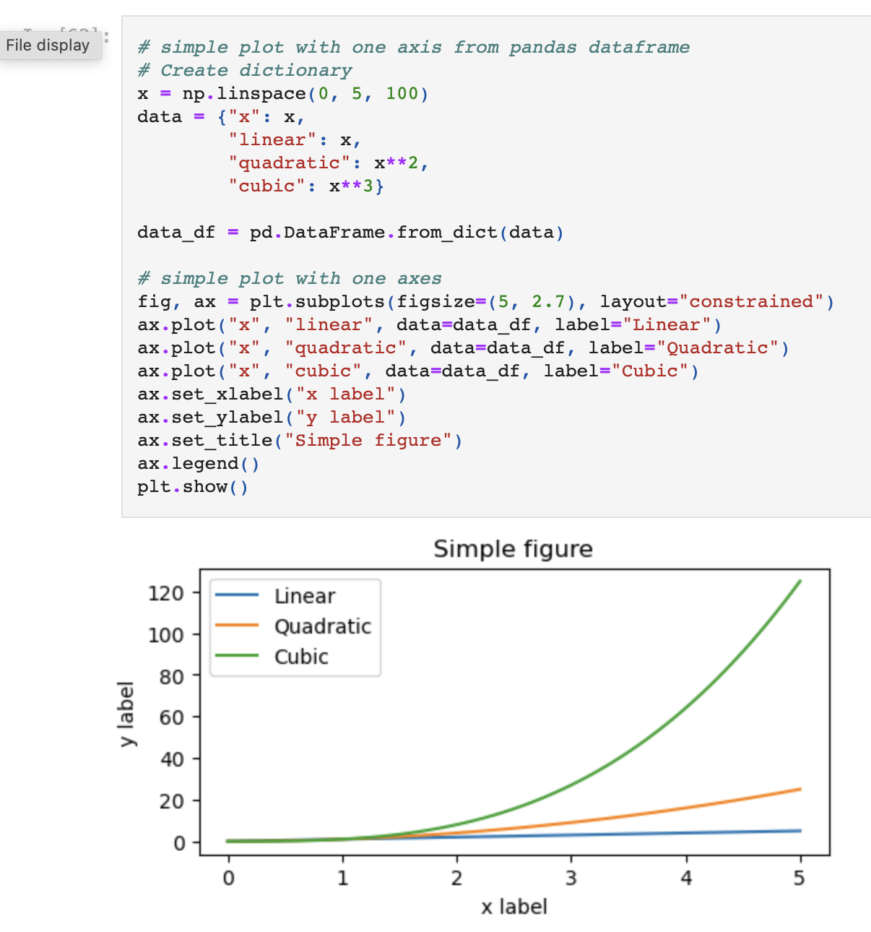
Visualisation example
With Matplotlib

Slide 38
Overview of the content
Python is based around Object-Oriented Programming
We’ve looked at the basic essential libraries NumPy, pandas, SciPy, and matplotlib
We used matplotlib for a first look at visualization

